Slide 1
MIS 6356 BA with R

Slide 2
Agenda
Administrative
Group Formation
Hands-On
Data Types in R
Data Exploration and Visualization
Hands-on
Data Exploration and Visualization

Slide 3
Data Types in R

Slide 4
Exercise
Create a 10 x 10 matrix called my_matrix and assign it the numbers 1 – 100
Create a 10 x 10 dataframe called my_dataframe and assign it the numbers 1 – 100
Write code to copy the first column of my_matrix and store the results in a variable called column1
Write code to copy the first column of my_dataframe and store the results in a variable called column1
What are the major ways the syntax for dataframes and matrices are similar? How are they different?

Slide 5
Purpose of Exploration
Summarize and explore the dataset to better understand it
Create summary statistics
Visualize the data using histograms, scatter plots and box plots
Is anything important missing?
Helps ensure alignment between model and business need

Slide 6
Data Visualization and Exploration

Slide 7
Cross Industry Standard Process for Data Mining (CRISP)
Business Understanding
Data Understanding
Data Preparation
Modeling
Evaluation
Deployment
Source: Wikipedia

Slide 8
Three Step Process
Describe the Dataset
Short description – one or two sentence summary
Unit of analysis - What does a row represent?
Size – How many rows and columns?
Source – How and where were the data obtained?
Explore and Summarize (Single Variable)
Summary statistics
Histograms
Box Plots
Explore Basic Relationships (Pairs of Variables)
Line Graphs
Bar Charts
Scatterplots
Correlation Matrix

Slide 9
Boston Housing Dataset
Dataset from the textbook
506 observations (aka cases or rows)
14 columns or features for census tracts in the Boston Area
Download available on eLearning

Slide 10
Boston Housing Data Set Variable Description
Column Name | Description
CRIM | Crime rate
ZN | Percentage of residential land zoned for lots over 25,000 ft²
INDUS | Percentage of land occupied by nonretail business
CHAS | Charles River dummy variable (=1 if tract bounds river; =0 otherwise)
NOX | Nitric oxide concentration (parts per 10 million
RM | Average number of rooms per dwelling
AGE | Percentage of owner-occupied units built prior to 1940
DIS | Weighted distances to five Boston employment centers
RAD | Index of accessibility to radial highways
TAX | Full-value property tax rate per $10,000
PTRATIO | Pupil/teacher ratio by town
LSTAT | % lower status of the population
MEDV | Median value of owner-occupied homes in $1,000
CAT.MEDV | Is median value of owner-occupied homes in tract above $30,000 (CAT.MEDV = 1) or not (CAT.MEDV = 0)
Source: Schmueli et al.

Slide 11
Data Exploration – Summary Statistics
For each variable of interest, provide the following
Mean and Median
Minimum, Maximum, Range, and IQR
Standard Deviation and Variance
Histogram
Box Plot

Slide 12
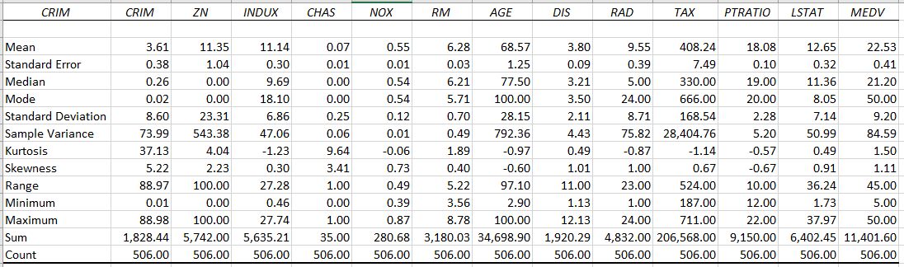
Boston Housing Summary Statistics in Excel

Slide 13
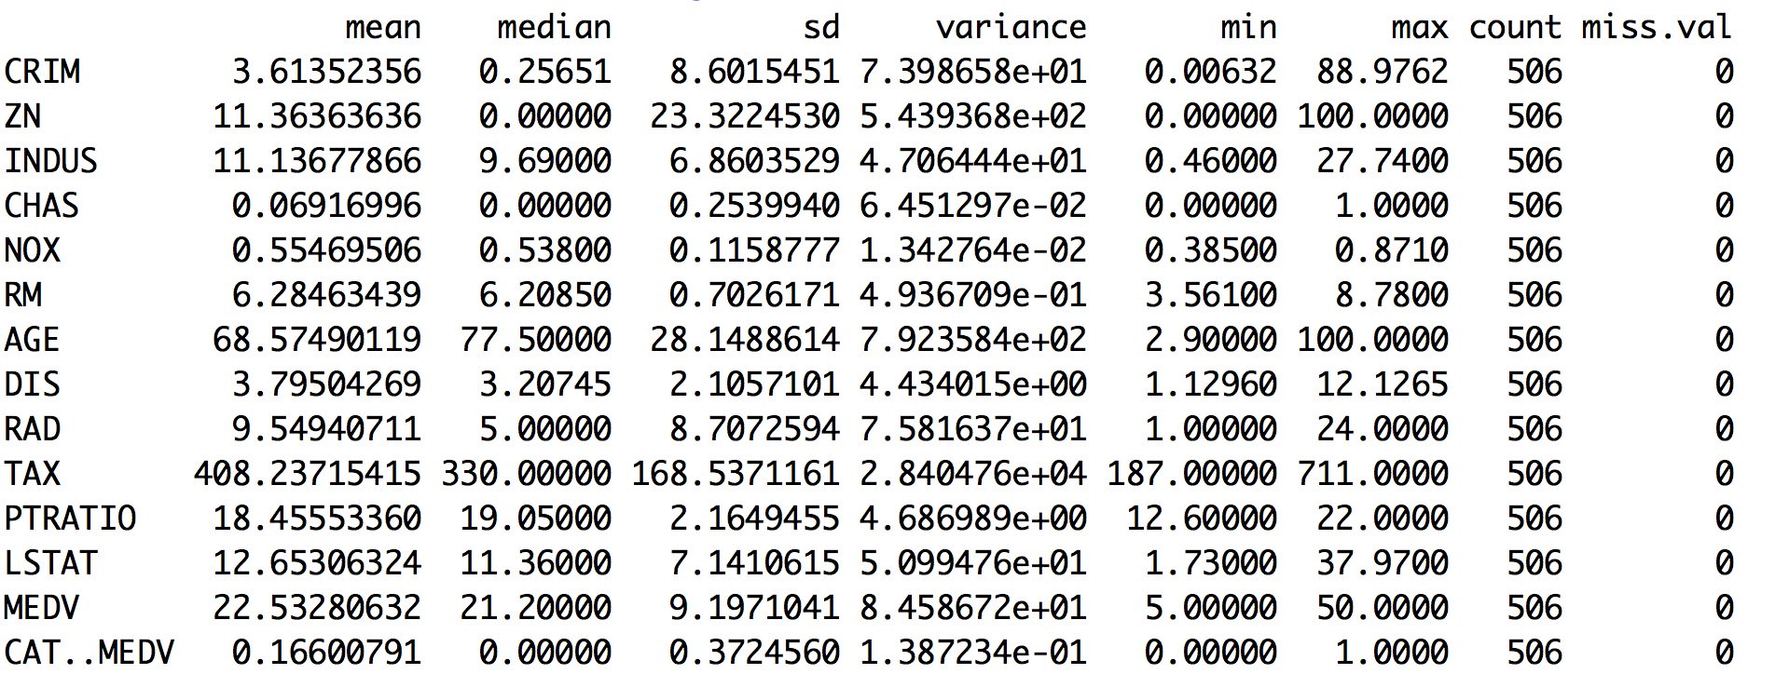
Boston Housing Summary in R

Slide 14
Histogram
Frequency plot of all data values for a given variable
x-axis has bins
y-axis displays the count of each bin
Used to visually inspect the shape and type of distribution

Slide 15
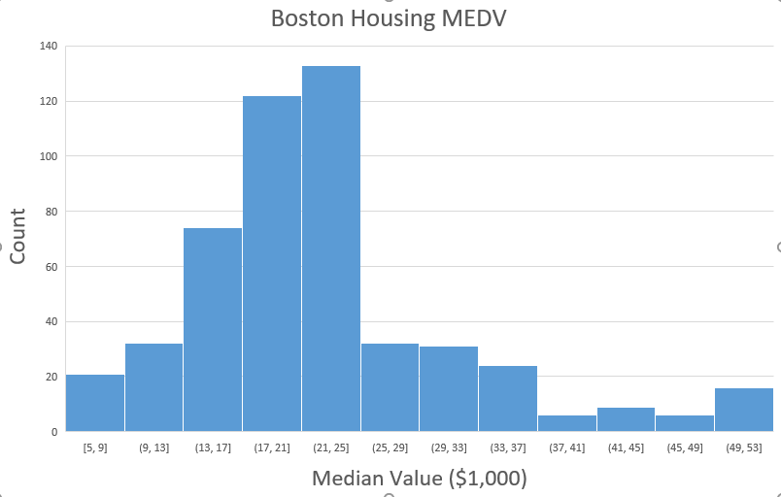
Boston Housing Histogram Example
Bins

Slide 16
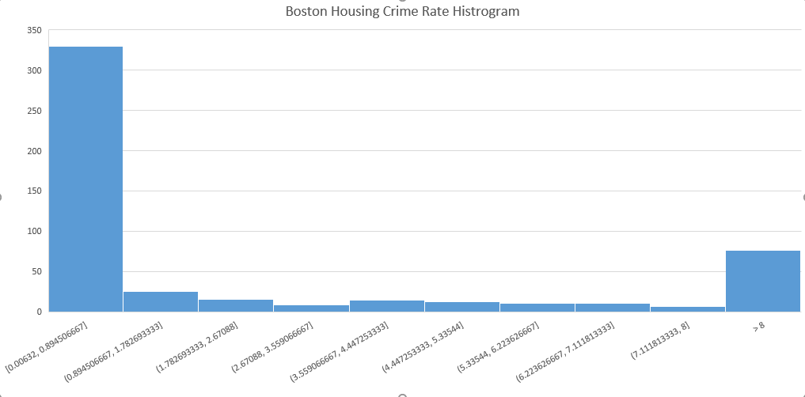
Boston Housing Histogram Example

Slide 17
Box Plot
Displays Summary Statistics Graphically

Slide 18
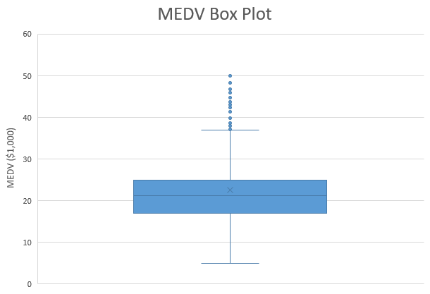
Outliers
Upper Whisker (75th percentile + 1.5 x IQR)
Interquartile Range (IQR)
(75th percentile – 25th percentile)
Mean
75th Percentile
Median (50th Percentile)
25th Percentile
Lower Whisker (25th percentile – 1.5 x IQR)

Slide 19
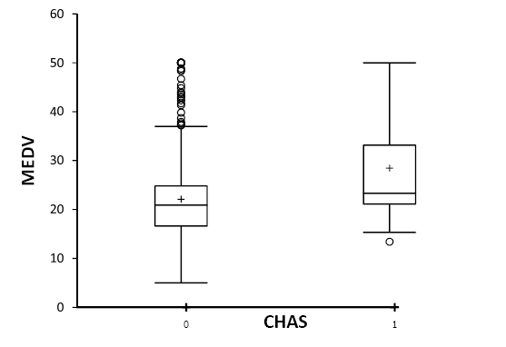
Boxplots
Side-by-side boxplots are useful for comparing subgroups
Boston Housing Example: Display distribution of outcome variable (MEDV) for neighborhoods on Charles river (1) and not on Charles river (0)
Source: Data Mining for Business Analytics (3rd ed.) by Shmueli, Bruce & Patel

Slide 20
Common Data Distributions
Normal
t distribution
Uniform
Binomial
Examples
Notes:
Uniform distribution examples: roll a six sided die 100 times

Slide 21
Normal Distribution Measures
Skewness
Distribution mode shifted left (positive) or right (negative)
Rule of thumb: if skewness is between +- 2, then assumption of normality is OK
Kurtosis
Distribution has more centrality (positive) or data concentrated near the extremes (negative)
Rule of thumb: if skewness is between +- 7, then assumption of normality is OK
q-q plot
Normalized plot of observed vs. expected values
Shapiro Wilke’s W Test and/or Kolmogorov-Smirnov Test
Statistical test of normality

Slide 22
Data Exploration – Basic Relationships
Line Graphs
Bar Charts
Scatter Plots
Correlation Matrices
Geographic Plots (Optional)
Principal Components Analysis

Slide 23
Relationships - Scatter Plots
Two variables at a time
One variable on x axis the other variable on the y axis
Should create scatter plots for all possible combinations of variables
Question: If we have 8 variables in our dataset, how many scatter plots should we have?
n x (n-1)

Slide 24
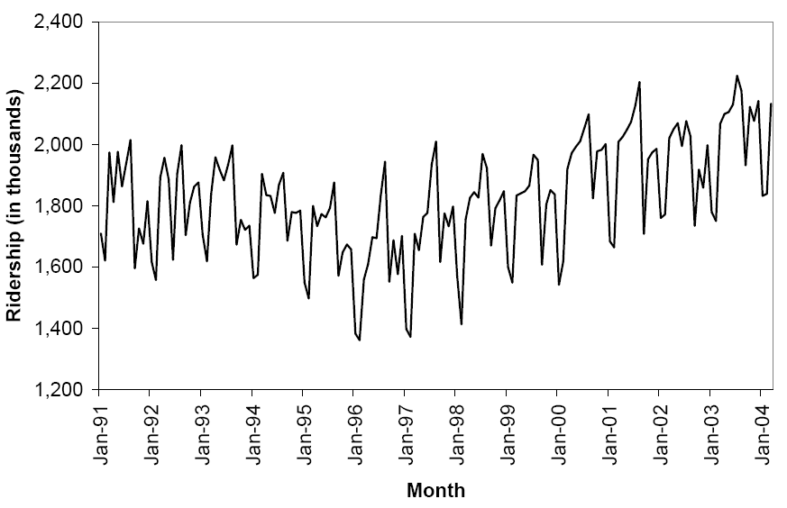
Line Graph for Time Series
Source: Data Mining for Business Analytics (3rd ed.) by Shmueli, Bruce & Patel

Slide 25
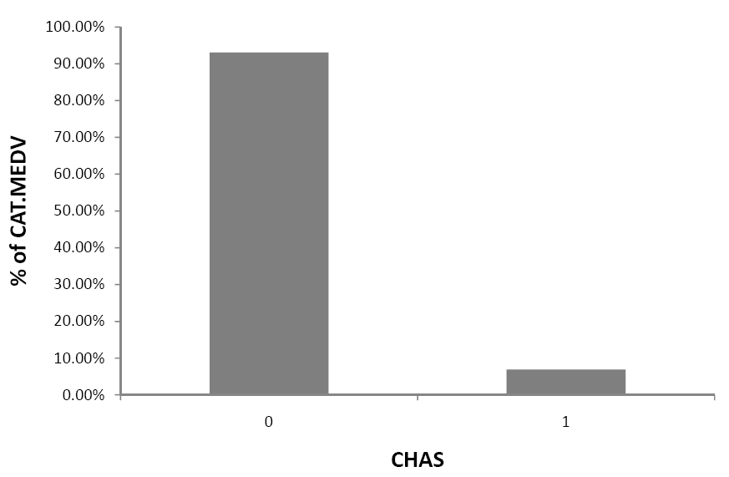
Bar Chart for Categorical Variable
95% of tracts do not border Charles River
Excel can confuse: y-axis is actually “% of records that have a value for CATMEDV” (i.e., “% of all records”)
Source: Data Mining for Business Analytics (3rd ed.) by Shmueli, Bruce & Patel

Slide 26
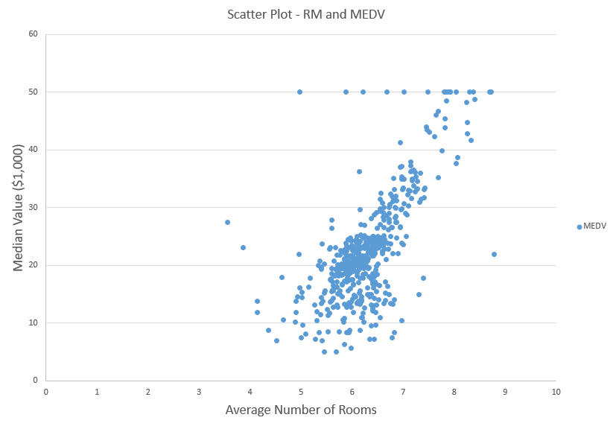
Scatter Plot Example

Slide 27
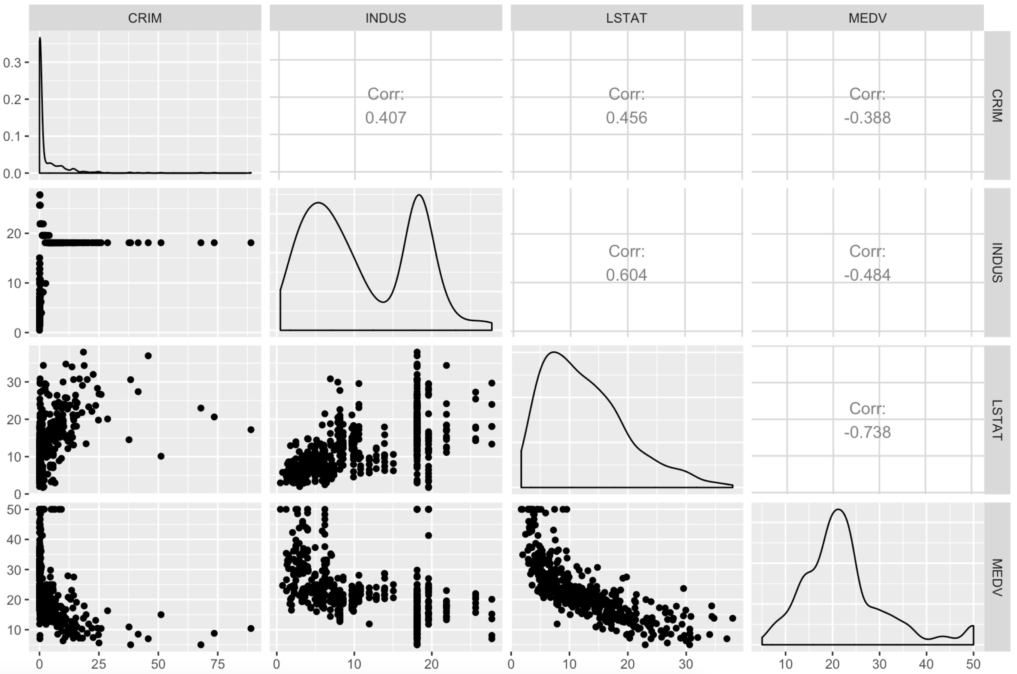

Slide 28
Correlation and Correlation Matrix
Correlation is the tendency for two variables to change together
Correlation formula
Correlation may be between -1 and +1
Correlation Matrix
n x n table of correlations
Variables listed on x and y axis

Slide 29
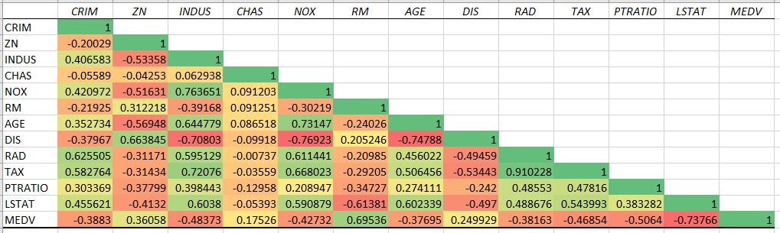
Correlation Matrix

Slide 30
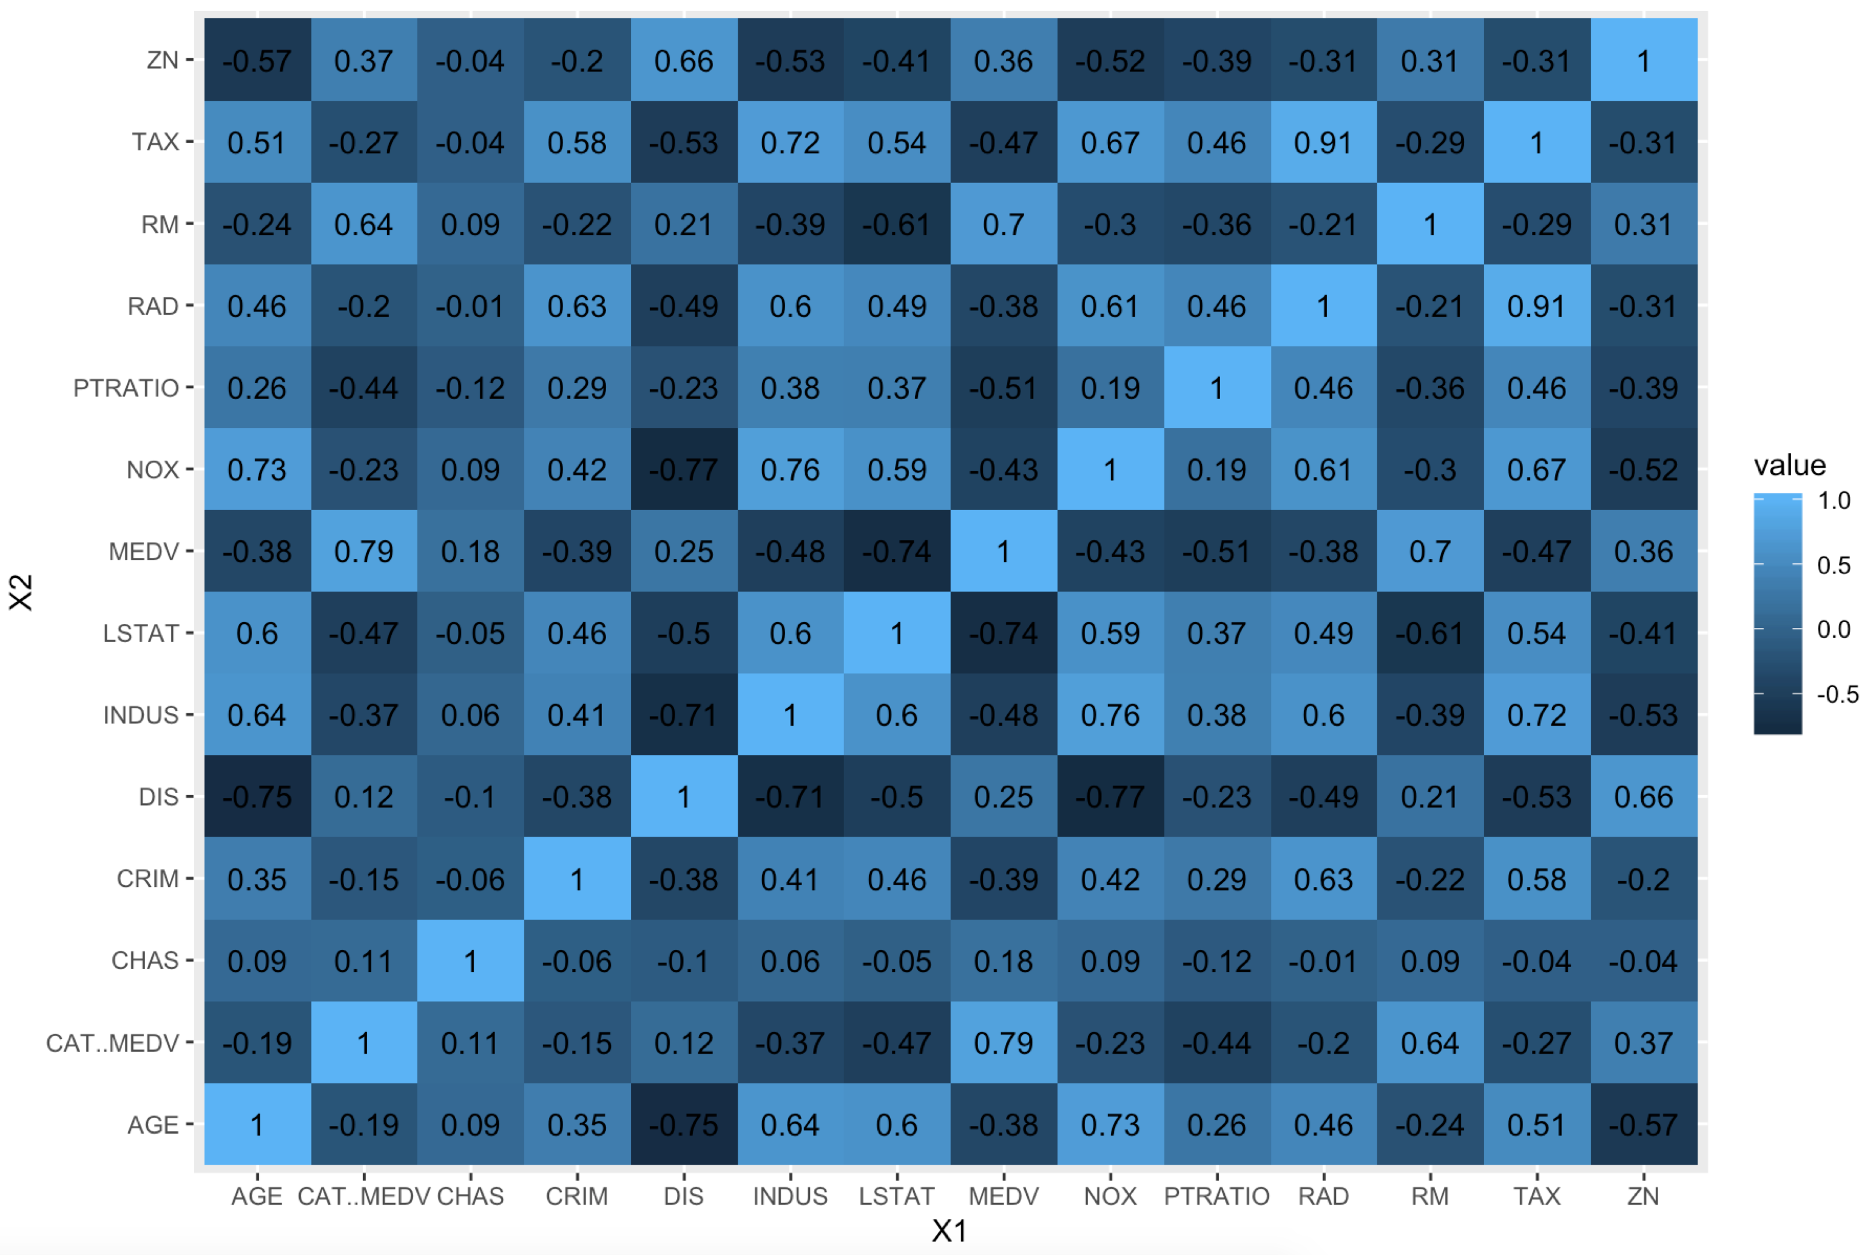

Slide 31
Tools

Slide 32
Tools - Excel
Summary Statistics
Data Analysis Add-In
Excel Charts
Histogram
Box Plot
Scatter Plot
Correlation Matrix
Data Analysis Add-In

Slide 33
Tools – R
Importing and Exporting the Data
Import CSV File
Import Excel File
Summary Statistics
stat
Charts
Histogram
Box Plot
Scatter Plot
Correlation Matrix

Slide 34
Hands-On
Using the diamonds dataset in tidyverse create the following in both R and Excel
Detailed summary statistics for all numeric and integer variables
Include mean, median, sd, variance, min, max, count, missing values
Histogram of price
Side by side boxplot with cut on the x axis and price on the y axis
Side by side boxplot with color in the x axis and price on the y axis
Scatter plot of carat on the x axis and price on the y axis
Scatter plot matrix of carat, x, y, z, and price
GGalley correlation matrix of carat, x, y, z, and price

Slide 35
Data Sources and Data Management

Slide 36
Working with Data
Look for a Data Dictionary
Read the readme file
Dataset will come as either a single flat file or multiple files
Multiple files require extra work
Common file formats
.csv, .txt
After downloading, try opening it with Excel
Up-to 1,000,000 records

Slide 37
Refining your Model Questions
What are some possible dependent variables?

Slide 38
Pre-processing Data
Source: Data Mining for Business Analytics (3rd ed.) by Shmueli, Bruce & Patel

Slide 39
Types of Variables
Determine the types of pre-processing needed, and algorithms used
Main distinction: Categorical vs. numeric
Numeric
Continuous
Integer
Categorical (Ordered Unordered)
Ordered (low, medium, high)
Unordered (male, female)
Source: Data Mining for Business Analytics (3rd ed.) by Shmueli, Bruce & Patel

Slide 40
Variable handling
Numeric
Most algorithms in R can handle numeric data
May occasionally need to “bin” into categories
Categorical
May need to create binary dummies (number of dummies = number of categories – 1)
Source: Data Mining for Business Analytics (3rd ed.) by Shmueli, Bruce & Patel

Slide 41
Detecting Outliers
An outlier is an observation that is “extreme”, being distant from the rest of the data (definition of “distant” is deliberately vague)
Outliers can have disproportionate influence on models (a problem if it is spurious)
An important step in data pre-processing is detecting outliers
Once detected, domain knowledge is required to determine if it is an error, or truly extreme.
Source: Data Mining for Business Analytics (3rd ed.) by Shmueli, Bruce & Patel

Slide 42
Detecting Outliers
In some contexts, finding outliers is the purpose of the DM exercise (airport security screening). This is called “anomaly detection”.
Source: Data Mining for Business Analytics (3rd ed.) by Shmueli, Bruce & Patel
Notes:
42

Slide 43
Handling Missing Data
Most algorithms will not process records with missing values. Default is to drop those records.
Solution 1: Omission
If a small number of records have missing values, can omit them
If many records are missing values on a small set of variables, can drop those variables (or use proxies)
If many records have missing values, omission is not practical
Solution 2: Imputation
Replace missing values with reasonable substitutes
Lets you keep the record and use the rest of its (non-missing) information
Source: Data Mining for Business Analytics (3rd ed.) by Shmueli, Bruce & Patel

Slide 44
Normalizing (Standardizing) Data
Used in some techniques when variables with the largest scales would dominate and skew results
Puts all variables on same scale
Normalizing function: Subtract mean and divide by standard deviation
Alternative function: scale to 0-1 by subtracting minimum and dividing by the range
Useful when the data contain dummies and numeric
Source: Data Mining for Business Analytics (3rd ed.) by Shmueli, Bruce & Patel

